Slide 1


DEPARTMENT OF COMPUTER SCIENCE AND ENGINEERING
20CS8504 & PROJECT WORK
END SEMESTER PRACTICAL EXAMINATION- APRIL / MAY - 2026
Batch No: 10
Date: 30.03.26
Session: AN

Slide 2
AI-Based Silent Performance Degradation Detection in Computer Systems Using Multivariate Time-Series Analysis
Guide Name:
Ms SHAHINA SHALU S
Team Members:
SUBITHA G (811722104159)
SWETHALASHMI G (811722104167)
VARSHAA S R (811722104175)

Slide 3
OBJECTIVE OF THE PROJECT
To detect early performance degradation in computer systems using time series analysis.
To analyse multivariate system metrics and identify gradual performance drift without explicit failure alerts.
To provide explainable degradation detection by identifying root causes using interpretable ML techniques.
To generate intelligent and reliable alerts while reducing false positives.
To support proactive maintenance for improved system reliability, uptime, and operational efficiency

Slide 4
INTRODUCTION
Modern computer systems rely on continuous monitoring, yet silent performance degradation often progresses unnoticed without explicit failure alarms.
To develop an unsupervised multivariate time-series framework that detects early silent degradation using explainable machine learning techniques proactively
A proactive monitoring system that identifies root causes, recommends actions, reduces downtime, and improves operational reliability overall.

Slide 5
LITERATURE SURVEY
TITLE OF PAPER | AUTHOR(S) | PAPER GIST | TECHNOLOGY USED
Predictive Maintenance Edge AI Application Study Using Recurrent Neural Networks for Early Aging Detection in Peristaltic Pumps | Juan M. Montes-Sánchez , Graduate Student Member, IEEE,2025 | IEEE Journal of Power and Energy Systems | Edge AI , Peristaltic pumps, gated recurrent neural networks
Predictive Analysis of System Performance Degradation Using Machine Learning Techniques | Ravi Kumar, Ananya Sharma, Pradeep Nair, 2024 | IEEE Access | ML –based predictive analytics; Time-series analysis; CPU, memory, disk, and system log monitoring
A Centralized Monitoring Framework for Predicting System Failures in Large-Scale IT Environments | Daniel Brown, Karthik Ramesh, Sunita Patel, 2024 | IEEE Systems Journal | Centralized monitoring architecture; Predictive failure analysis; ML models using CPU, RAM, disk, network metrics
Reinforcement Learning-Driven Adaptive Prefetch Aggressiveness Control for Enhanced Performance in Parallel System Architectures | Huijing Yang, Juan Fang, Neal N. Xiong, Yumin Hou, Xing Su, 2025 | IEEE Transactions on Parallel and Distributed Systems | Reinforcement Learning (RL)-based adaptive prefetch control for multi-core systems
Deep Learning-Based Log Analysis for Failure Detection in Distributed Systems | Min Du, Feifei Li,2024 | IEEE Deep Learnings techniques and system logs | Deep Learning, Log Analysis, Distributed System Monitoring
Disk Failure Prediction in Data Centers Using Machine Learning | Q. Guan,2025 | IEEE Disk failures and health monitoring | Machine Learning, Disk Health Monitoring, Data Center Reliability
Edge Computing for Internet of Things: A Survey | Weisong Shi , 2024 | IEEE Edge Computing | Edge Computing, IoT Architecture, Distributed Systems.

Slide 6
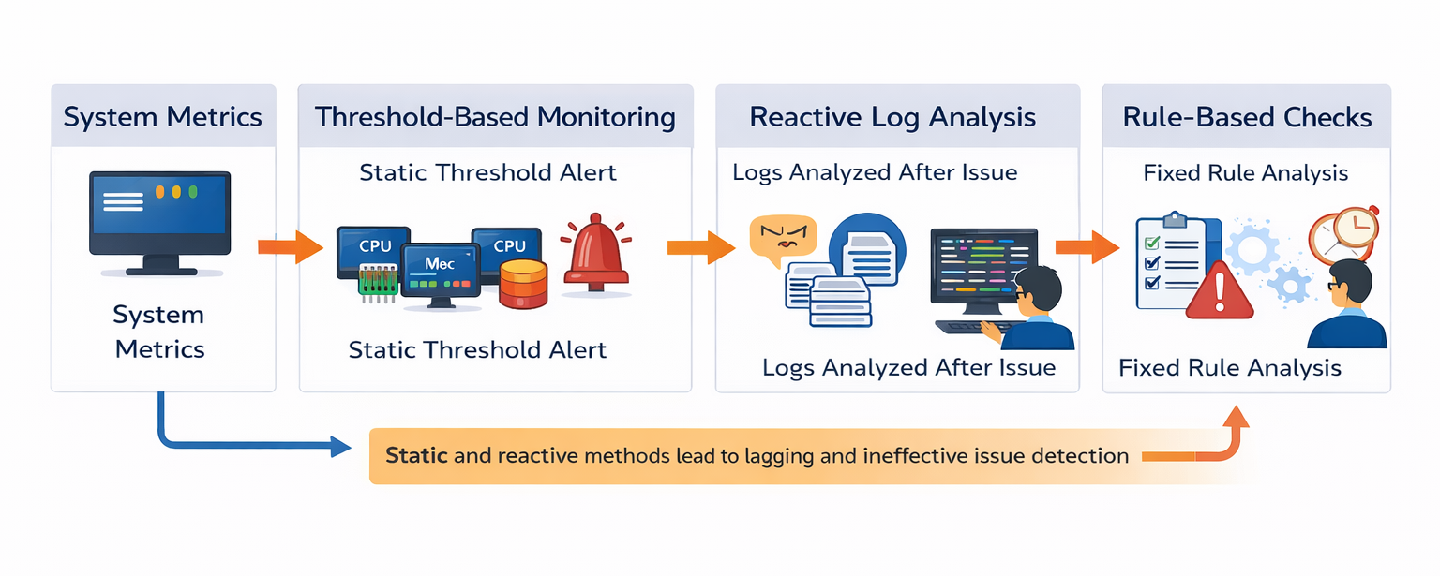
EXISTING SYSTEM ARCHITECTURE

Slide 7
PROBLEM IDENTIFICAITON
1. Modern computer systems use monitoring methods such as threshold-based monitoring, log analysis, performance monitoring tools, and rule-based alert systems to track system performance.
2.In threshold-based monitoring, alerts are generated when system metrics like CPU usage, memory utilization, disk activity, or network traffic exceed predefined limits.
3.Log analysis and monitoring tools help administrators observe system behavior through logs, dashboards, and performance reports.
4.However, these traditional monitoring methods are mostly reactive and often fail to detect gradual or hidden performance degradation.
5.Therefore, an advanced monitoring approach is needed to automatically analyze system trends, detect early degradation, and provide intelligent insights for improving system reliability and efficiency.

Slide 8
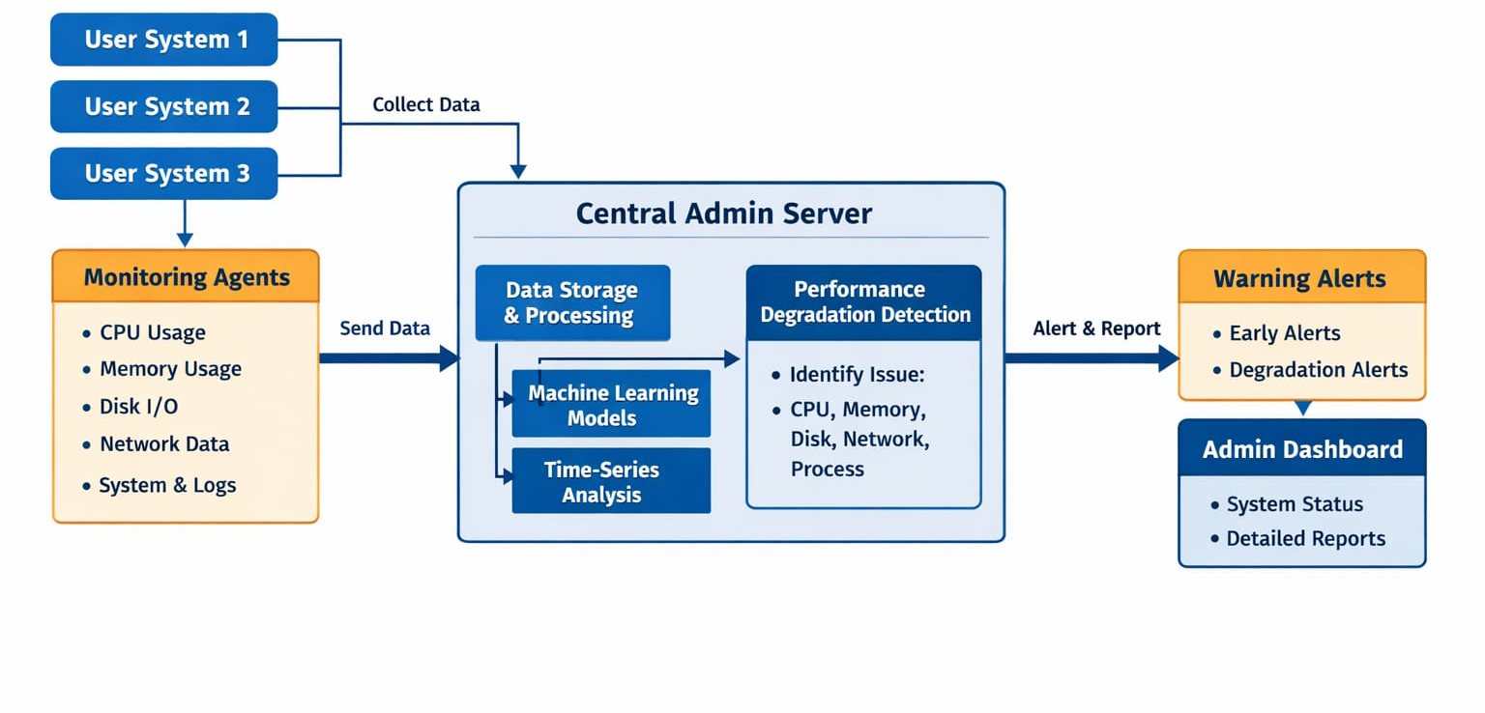
PROPOSED SYSTEM ARCHITECTURE

Slide 9
SOFTWARE AND HARDWARE REQUIREMENTS
HARDWARE
1. Processor: Minimum Intel i5
2. RAM: 16 GB
3. Storage: 512 GB SSD
SOFTWARE
1. Operating System: Windows 11
2. Development Platform: Python 3.9
3. Frameworks: Flask
4. Database: MySQL

Slide 10
MODULES
1.System Degradation Analyzer
2.System User
3.Server Management
4.Model Development
5.Monitoring Agent
6. Anomaly Detection
7.Recommendation Engine
8.Alerts and Notification

Slide 11
IMPLEMENTATION OF MODULE-1
System Degradation Analyzer
1. The System Degradation Analyzer acts as the central web-based platform that manages system monitoring and performance analysis.
2. It is developed using Python and Flask, with MySQL used for database management and Bootstrap for designing the user interface.
3. The module integrates key functionalities such as user management, system registration, monitoring data processing, and alert generation.
4. It provides a dashboard interface where users can view system performance metrics, anomaly detection results, and alerts.
5. Libraries like NumPy, Pandas, PyTorch, and SHAP are used for data processing, machine learning analysis, and performance interpretation.

Slide 12
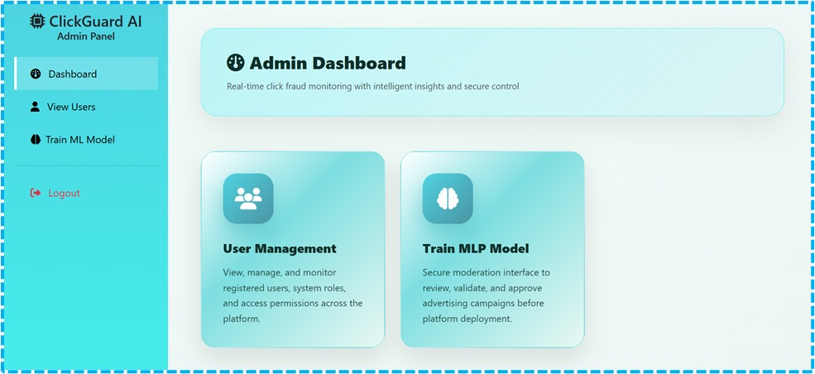
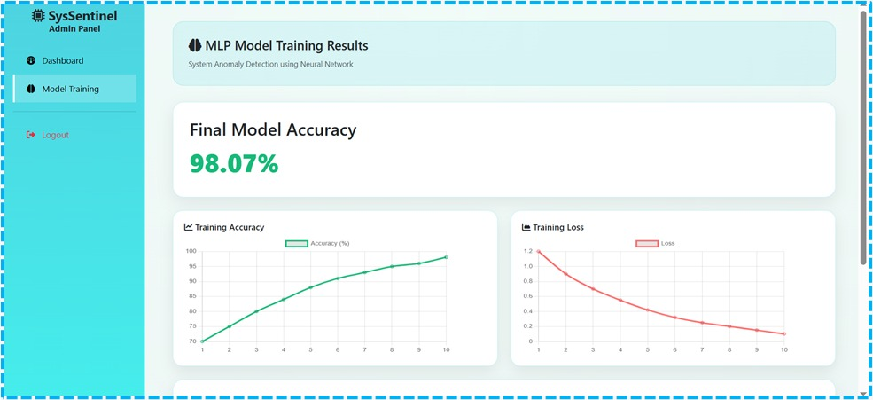
IMPLEMENTATION OF MODULE-2
System User
1. This module manages users who interact with the system and controls their access, authentication, and authorization.
2. It includes two main roles: System Administrator and User/Server Administrator, each with different responsibilities.
3. The System Administrator manages the platform, uploads datasets, supervises users, and monitors system performance and anomaly detection results.
4. The User/Server Administrator registers and logs into the system to monitor their servers or computer systems.
5.Users can view system metrics, alerts, anomaly detection results, and recommendations through the dashboard to maintain system health.

Slide 13
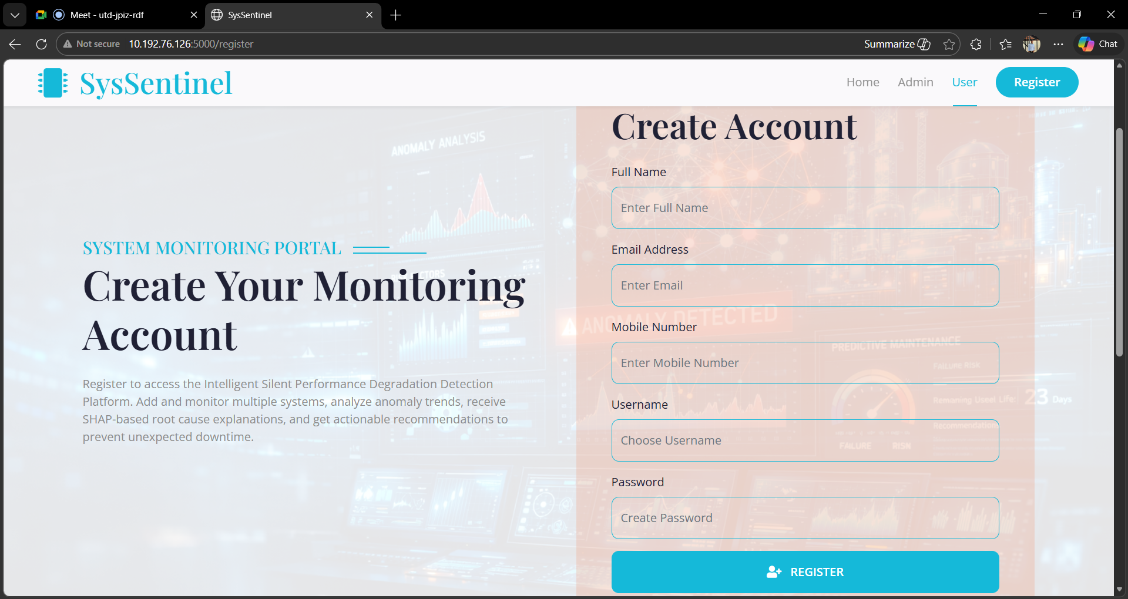
IMPLEMENTATION OF MODULE-3
Server Management
1. This module manages the registration and configuration of computers or servers that need to be monitored.
2. Users can add system details such as system name, IP address, operating system, and hardware specifications.
3. Each registered system is linked to the user account for monitoring and management.
4. The module maintains records of all registered systems and their monitoring status.
5.It ensures that the monitoring agent is connected properly to collect and transmit system performance data for analysis.

Slide 14
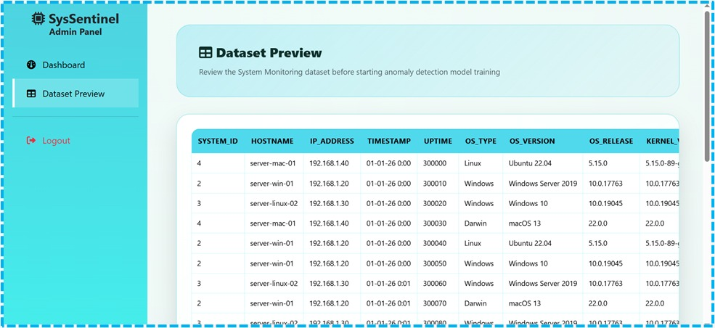
IMPLEMENTATION OF MODULE-4
Model Development
1. This module focuses on developing the machine learning model used to analyze system performance and detect abnormal patterns.
2. The administrator uploads datasets containing system metrics such as CPU usage, memory usage, disk activity, network latency, and process information.
3. Data preprocessing cleans and organizes the dataset by removing missing values and normalizing the data for accurate analysis.
4. Feature extraction identifies important system metrics that influence performance and improves model efficiency.
5.The model is trained using historical data and then deployed to analyze real-time monitoring data and detect performance degradation.

Slide 15
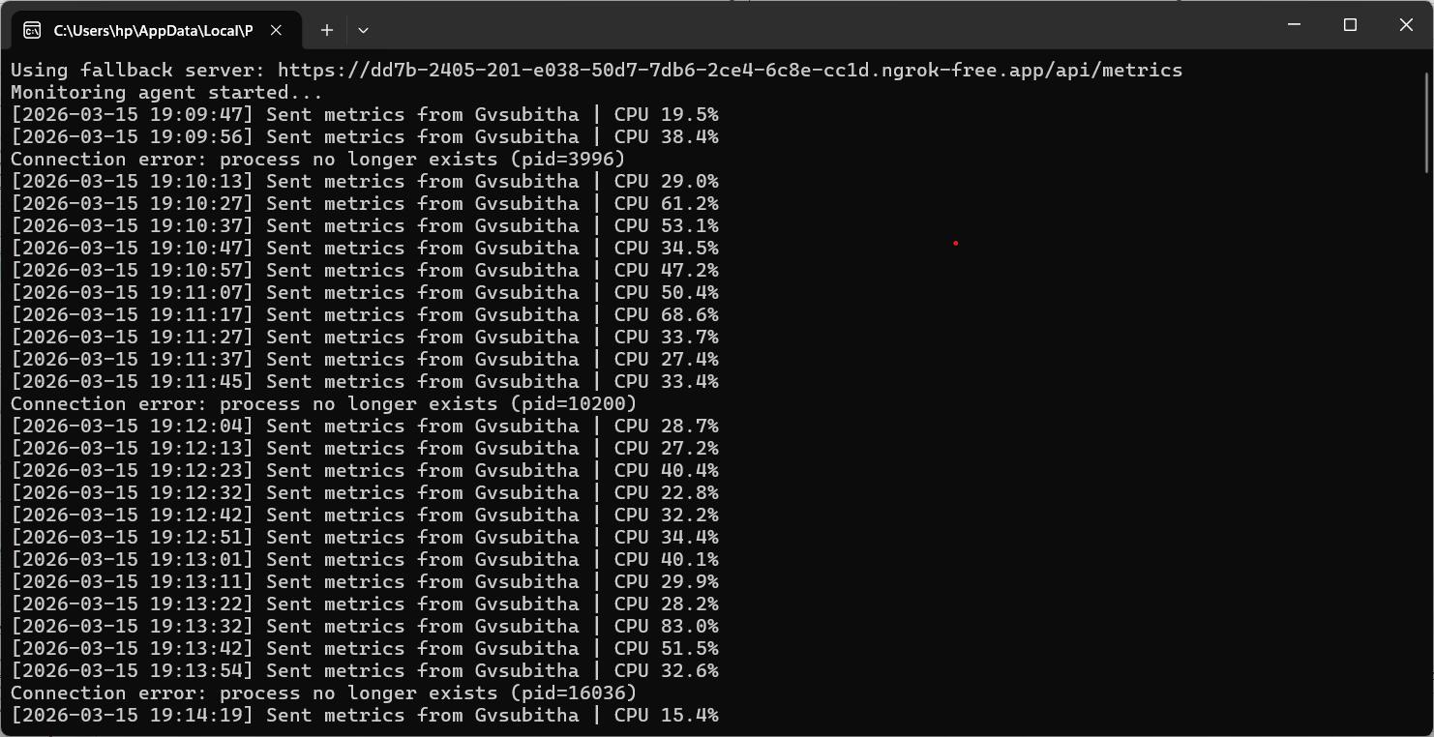
IMPLEMENTATION OF MODULE-5
Monitoring Agent
1. This module collects system performance metrics from monitored computers or servers for continuous analysis.
2. The monitoring agent runs in the background of each registered system and gathers important data such as CPU usage, memory utilization, disk activity, network latency, and process count.
3. System metrics are collected at regular time intervals and transmitted to the central analysis server for further processing.
4. The module ensures that accurate and real-time performance data is available for monitoring and analysis.
5.By automating the data collection process, the monitoring agent supports machine learning analysis and helps in detecting anomalies or performance degradation.

Slide 16
IMPLEMENTATION OF MODULE-6
Anomaly Detection
1. This module analyzes collected system performance metrics to identify unusual patterns that may indicate system performance degradation.
2. Machine learning algorithms learn the normal behavior of system performance using historical data.
3. New incoming metrics are compared with the learned patterns to determine whether the system behavior is normal or abnormal.
4. If a significant deviation is detected, the system generates an anomaly score indicating the severity of the issue.
5. Early anomaly detection helps administrators take preventive actions, improving system reliability and reducing unexpected downtime.

Slide 17
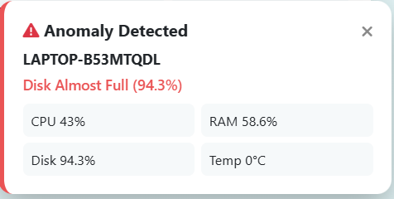
IMPLEMENTATION OF MODULE-7
Recommendation Engine
1. This module provides corrective recommendations based on the results from anomaly detection and system analysis.
2. It identifies the root cause of performance degradation and generates suitable actions to resolve the issue.
3. Recommendations may include optimizing system resources, restarting services, or checking affected system components.
4. The module helps administrators quickly understand and fix system performance problems.
5. By providing clear guidance, it reduces troubleshooting time and improves overall system efficiency.

Slide 18
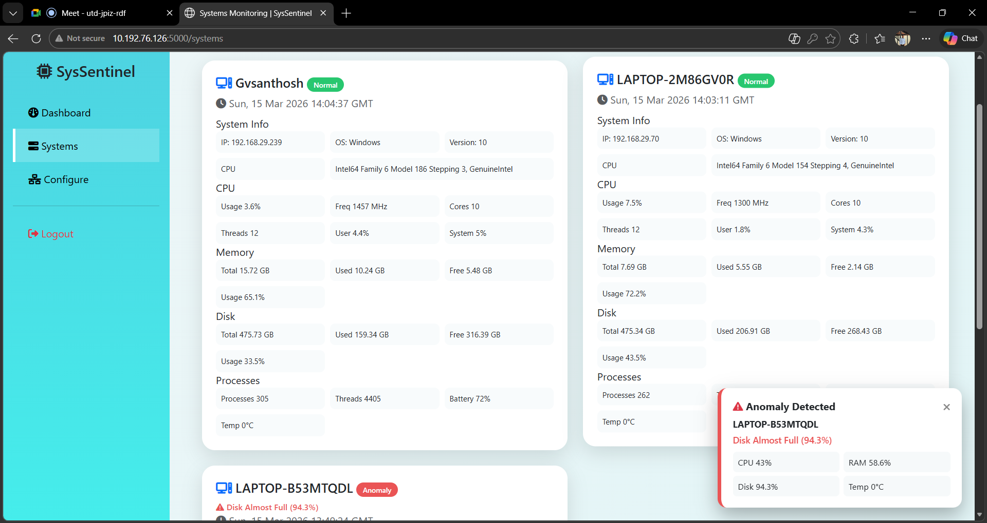
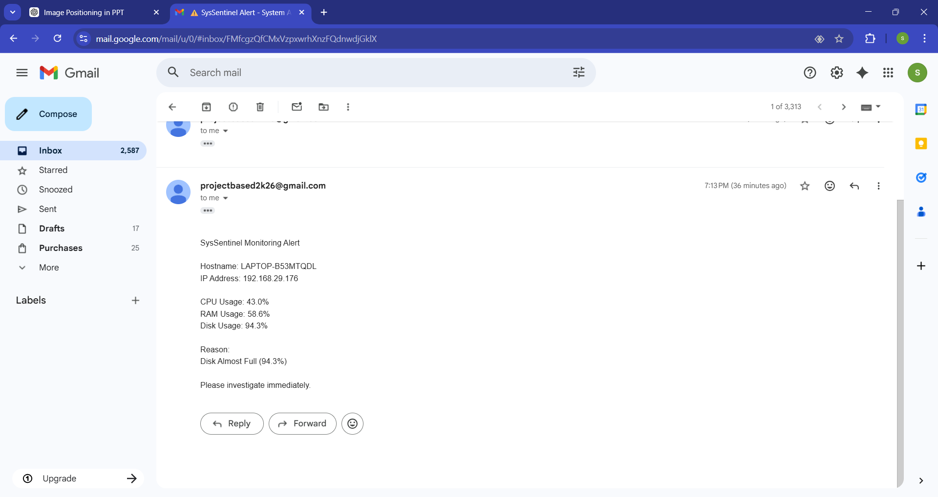
IMPLEMENTATION OF MODULE-8
Alerts and Notification
1. This module notifies users when abnormal system behavior or performance degradation is detected.
2. When an anomaly is identified, the system generates alert messages for administrators.
3. Alerts are displayed on the monitoring dashboard and can also be sent through email notifications.
4. The module categorizes alerts based on severity so administrators can prioritize critical issues.
5. Timely notifications help administrators take corrective actions quickly and prevent major system failures.

Slide 19
CONCLUSION
Presents a multivariate time-series framework for early detection of silent system performance degradation.
Integrates the OmniAnomaly model with SHAP-based explainability for accurate anomaly and root-cause detection.
Identifies gradual performance drift and provides actionable insights for administrators.
Enables proactive maintenance, reducing downtime and improving operational stability.
Delivers a reliable, interpretable, and automated solution for efficient system performance management.

Slide 20
FUTURE ENHANCEMENTS
1. The system can be extended to support cloud infrastructure monitoring by integrating with platforms such as AWS, Azure, and Google Cloud, allowing administrators to monitor both local and cloud-based systems from a single platform.
2.Real-time streaming analytics can be implemented to continuously process system metrics and detect anomalies instantly instead of analyzing data at fixed intervals.
3.The system can include automated self-healing mechanisms that automatically resolve certain performance issues such as restarting services, reallocating resources, or clearing system caches.
4.These enhancements will improve system reliability, reduce manual intervention, and enable faster detection and resolution of performance issues.

